Slide 1
Post Graduate Student Union Learning is Fun with Arduino 2017-18
Session-3
Working with the Arduino microcontroller
Engr S M Asim Ali
School of Computer Science ,
Beihang University

Slide 2
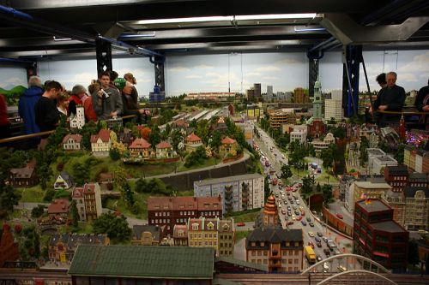
Automated Mini City
2

Slide 3
Mini City
Light sensitive street lights
Timed Traffic Lights
Automated Gates using proximity sensor
Cars that drive the City streets
3

Slide 4
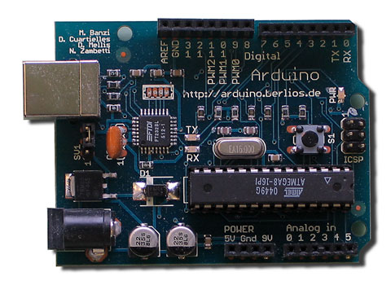
The Arduino UNO R3
Digital I/O (2 – 13)
Serial Transfer (0 -1)
USB (Data & Power)
Power Source
Jumper
Reset
Alternate Power (9V)
5V / 9V / GND (x2)
Analog Input (0 – 5)

Slide 5
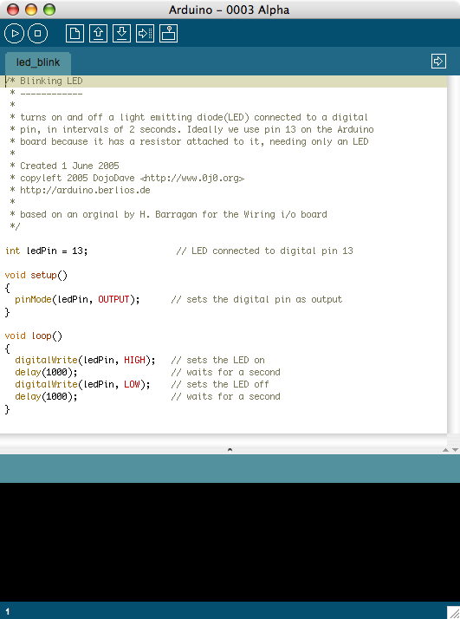
Compile
Upload to controller
Serial Monitor
Arduino
IDE
Window
Code Editor
Text Output (Serial Data)

Slide 6
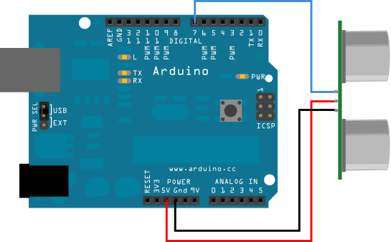
Arduino Code Basics
Commands and other information are sent to LED’s, motors and from sensors through digital and analog input & output pins

Slide 7
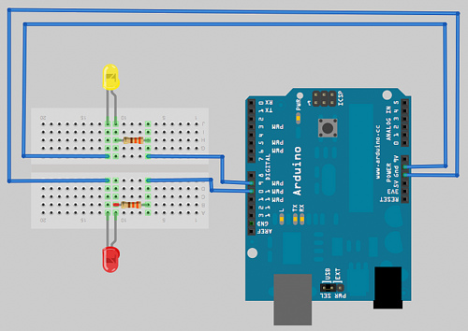
Setup - Adding an LED

Slide 8
Arduino Code Basics
Arduino programs run on two basic sections:
void setup() {
//setup motors, sensors etc
}
void loop() {
// get information from sensors
// send commands to motors
}

Slide 9
Setup
The setup section is used for assigning input and outputs (Examples: motors, LED’s, sensors etc) to ports on the Arduino
It also specifies whether the device is OUTPUT or INPUT
To do this we use the command “pinMode”
9

Slide 10
Setup
void setup() {
pinMode(9, OUTPUT);
}
port #
Input or Output
http://www.arduino.cc/en/Reference/HomePage

Slide 11
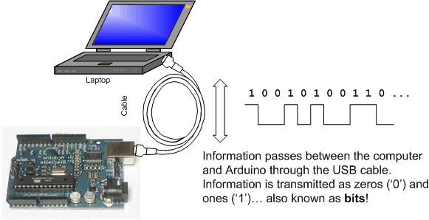
Serial Communication
Image from http://www.ladyada.net/learn/arduino/lesson4.html

Slide 12
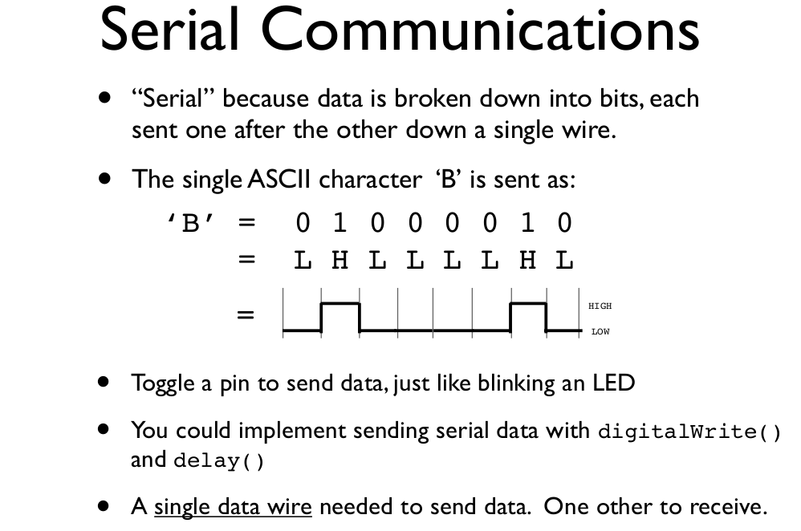

Slide 13
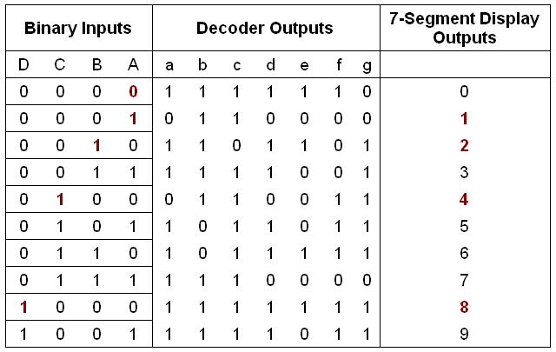
Truth Tables for Boolean Algebra

Slide 14
Loop
void loop() {
digitalWrite(9, HIGH);
delay(1000);
digitalWrite(9, LOW);
delay(1000);
}
Port # from setup
Turn the LED on
or off
Wait for 1 second
or 1000 milliseconds

Slide 15
TASK 1
Using 3 LED’s (red, yellow and green) build a traffic light that
Illuminates the green LED for 5 seconds
Illuminates the yellow LED for 2 seconds
Illuminates the red LED for 5 seconds
repeats the sequence
Note that after each illumination period the LED is turned off!
15

Slide 16
TASK 2
Modify Task 1 to have an advanced green (blinking green LED) for 3 seconds before illuminating the green LED for 5 seconds
16

Slide 17
Variables
A variable is like “bucket”
It holds numbers or other values temporarily
value
17

Slide 18
DECLARING A VARIABLE
int val = 5;
assignment
“becomes”
Type
value
variable name

Slide 19
TASK 3
Replace all delay times with variables
Replace LED pin numbers with variables
19

Slide 20
Using Variables
int delayTime = 2000;
int greenLED = 9;
void setup() {
pinMode(greenLED, OUTPUT);
}
void loop() {
digitalWrite(greenLED, HIGH);
delay(delayTime);
digitalWrite(greenLED, LOW);
delay(delayTime);
}
Declare delayTime
Variable
Use delayTime
Variable

Slide 21
Using Variables
int delayTime = 2000;
int greenLED = 9;
void setup() {
pinMode(greenLED, OUTPUT);
}
void loop() {
digitalWrite(greenLED, HIGH);
delay(delayTime);
digitalWrite(greenLED, LOW);
delayTime = delayTime - 100;
delay(delayTime);
}
subtract 100 from
delayTime to gradually
increase LED’s blinking
speed

Slide 22
Conditions
To make decisions in Arduino code we use an ‘if’ statement
‘If’ statements are based on a TRUE or FALSE question

Slide 23
VALUE COMPARISONS
GREATER THAN
a > b
GREATER THAN OR EQUAL
a >= b
LESS
a < b
LESS THAN OR EQUAL
a <= b
EQUAL
a == b
NOT EQUAL
a != b

Slide 24
IF Condition
if(true)
{
“perform some action”
}
asdfadsf

Slide 25
IF Example
int counter = 0;
void setup() {
Serial.begin(9600);
}
void loop() {
if(counter < 10)
{
Serial.println(counter);
}
counter = counter + 1;
}

Slide 26
TASK 4
Create a program that resets the delayTime to 2000 once it has reached 0
26

Slide 27
Input & Output
Transferring data from the computer to an Arduino is done using Serial Transmission
To setup Serial communication we use the following
void setup() {
Serial.begin(9600);
}
27

Slide 28
Writing to the Console
void setup() {
Serial.begin(9600);
Serial.println(“Hello World!”);
}
void loop() {}

Slide 29
TASK 5
Modify your traffic light code so that each time a new LED is illuminated the console displays the status of the stoplight
Example
Advanced Green
Green
Yellow
Red
Advanced Green
...
29

Slide 30
IF - ELSE Condition
if( “answer is true”)
{
“perform some action”
}
else
{
“perform some other action”
}
asdfadsf

Slide 31
int counter = 0;
void setup() {
Serial.begin(9600);
}
void loop() {
if(counter < 10)
{
Serial.println(“less than 10”);
}
else
{
Serial.println(“greater than or equal to 10”);
Serial.end();
}
counter = counter + 1;
}

Slide 32
IF - ELSE IF Condition
if( “answer is true”)
{
“perform some action”
}
else if( “answer is true”)
{
“perform some other action”
}
asdfadsf

Slide 33
IF - ELSE Example
int counter = 0;
void setup() {
Serial.begin(9600);
}
void loop() {
if(counter < 10)
{
Serial.println(“less than 10”);
}
else if (counter == 10)
{
Serial.println(“equal to 10”);
}
else
{
Serial.println(“greater than 10”);
Serial.end();
}
counter = counter + 1;
}

Slide 34
BOOLEAN OPERATORS - AND
If we want all of the conditions to be true we need to use ‘AND’ logic (AND gate)
We use the symbols &&
Example
if ( val > 10 && val < 20)
34

Slide 35
BOOLEAN OPERATORS - OR
If we want either of the conditions to be true we need to use ‘OR’ logic (OR gate)
We use the symbols ||
Example
if ( val < 10 || val > 20)
35

Slide 36
TASK 5
Create a program that illuminates the green LED if the counter is less than 100, illuminates the yellow LED if the counter is between 101 and 200 and illuminates the red LED if the counter is greater than 200
36

Slide 37
INPUT
We can also use our Serial connection to get input from the computer to be used by the Arduino
int val = 0;void setup() { Serial.begin(9600); }void loop() { if(Serial.available() > 0) { val = Serial.read(); Serial.println(val); }
}

Slide 38
TASK 6
Using input and output commands find the ASCII values of
#
1
2
3
4
5
ASCII
49
50
51
52
53
#
6
7
8
9
ASCII
54
55
56
57
@
a
b
c
d
e
f
g
ASCII
97
98
99
100
101
102
103
@
h
i
j
k
l
m
n
ASCII
104
105
106
107
108
109
110
@
o
p
q
r
s
t
u
ASCII
111
112
113
114
115
116
117
@
v
w
x
y
z
ASCII
118
119
120
121
122

Slide 39
INPUT EXAMPLE
int val = 0;
int greenLED = 13;
void setup()
{
Serial.begin(9600);
pinMode(greenLED, OUTPUT);
}
void loop()
{
if(Serial.available()>0)
{
val = Serial.read();
Serial.println(val);
}
if(val == 53)
{
digitalWrite(greenLED, HIGH);
}
else
{
digitalWrite(greenLED, LOW);
}
}

Slide 40
TASK 7
Create a program so that when the user enters 1 the green light is illuminated, 2 the yellow light is illuminated and 3 the red light is illuminated
Create a program so that when the user enters ‘b’ the green light blinks, ‘g’ the green light is illuminated ‘y’ the yellow light is illuminated and ‘r’ the red light is illuminated
40

Slide 41
Task
Light Mode Video
Create a program that
when the user enters ‘1’ all lights turn on
when the user enters ‘2’ all lights flash
when the user enters ‘3’ lights cycle repeatedly
when the user enters ‘q’ or ‘e’ the lights turn off
when + or - is pressed the speed of the LED increase or decrease

Slide 42
BOOLEAN VARIABLES
boolean done = true;

Slide 43
Run-Once Example
boolean done = false;
void setup()
{
Serial.begin(9600);
}
void loop()
{
if(!done)
{
Serial.println(“HELLO WORLD”);
done = true;
}
}

Slide 44
TASK 8
Write a program that asks the user for a number and outputs the number that is entered. Once the number has been output the program finishes.
EXAMPLE:
Please enter a number: 1 <enter>
The number you entered was: 1
44

Slide 45
TASK 9
Write a program that asks the user for a number and outputs the number squared that is entered. Once the number has been output the program finishes.
Please enter a number: 4 <enter>
Your number squared is: 16

Slide 46
Christmas Light Assignment No 1
Using at least 5 LEDs create a program that has at least 4 different modes
Must use if statements and user input to switch modes
Marks:
Creativity [4 Marks]
Working user input [2 Marks]
Four Working modes [2 Marks]
Instructions [1 Mark]
46

